Slide 1
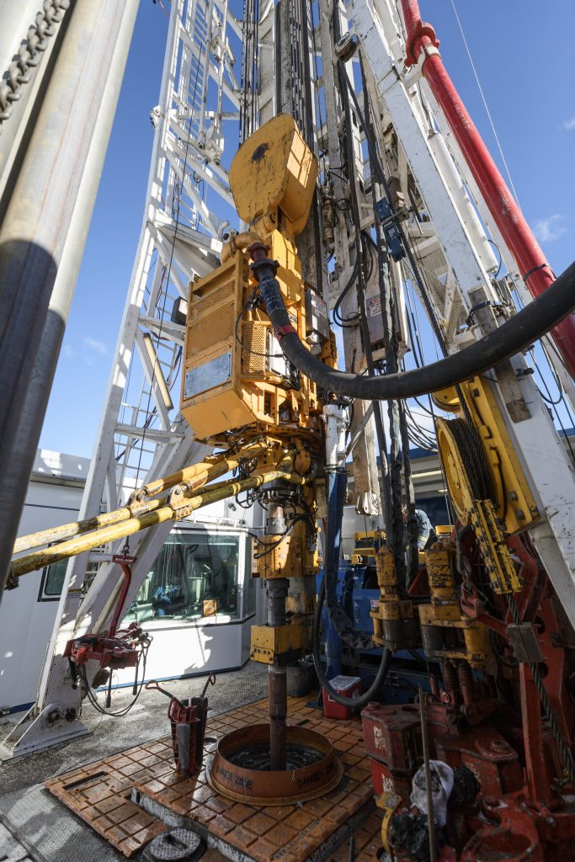

Capstone Project Presentation
Team 1
Group project
– 4 participants
- 2 weeks

Slide 2



Introduction
Our sponsor isRedacted. They are a private petroleum and natural gas company that owns wells in Alberta and Saskatchewan. They have given us data from Hydraulic Fracing wells, the data included information about their own wells, as well as other competitors in Alberta . They gave us the task to build visuals in Power Bi that may be used as a tool to determine how their competition is completing their wells and compare against production. If patterns arise, we can make recommendations for future projects, and they can use these tools in the future.

Slide 3

Objectives
Based on each Fracing Well in the data given to us, we searched for common trends in completion design parameters. We examined lateral length, number of frac stages and casing width to see if these choices caused a higher production rate.
We used Power BI by request to analyze trends in production, based on completion design choices. If production is high, we can recommend if that design is a good choice, based on patterns in the graphs.
Further we analyzed other factors that could increase production. These included examining each stage and each well for total frac fluid placed, usage and cut of water all normalized by time, so that we get a better picture of production based on 24 hours daily run time.

Slide 4
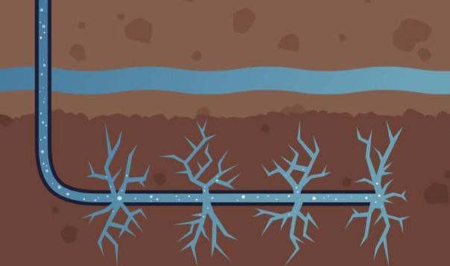
Background
Hydraulic fracturing is a complicated process that involves many calculations and decisions in its creation. Decisions include, how long the well needs to be in order to push past earths crust into the area to be fractured, how long the horizontal portion needs to be, how thick the casing liner will be to protect the surrounding areas which often include ground water pockets. Further, there are decisions involved with how many fractures are to happen, how much proppant and at what pressure in order to fracture the horizontal portion of the well to obtain oil and gas from deep within the earth. The picture below shows a simplified version of the process happening deep underground.
Oil Fracking Battle And PR Courts Controversy - PR News (everything-pr.com)

Slide 5
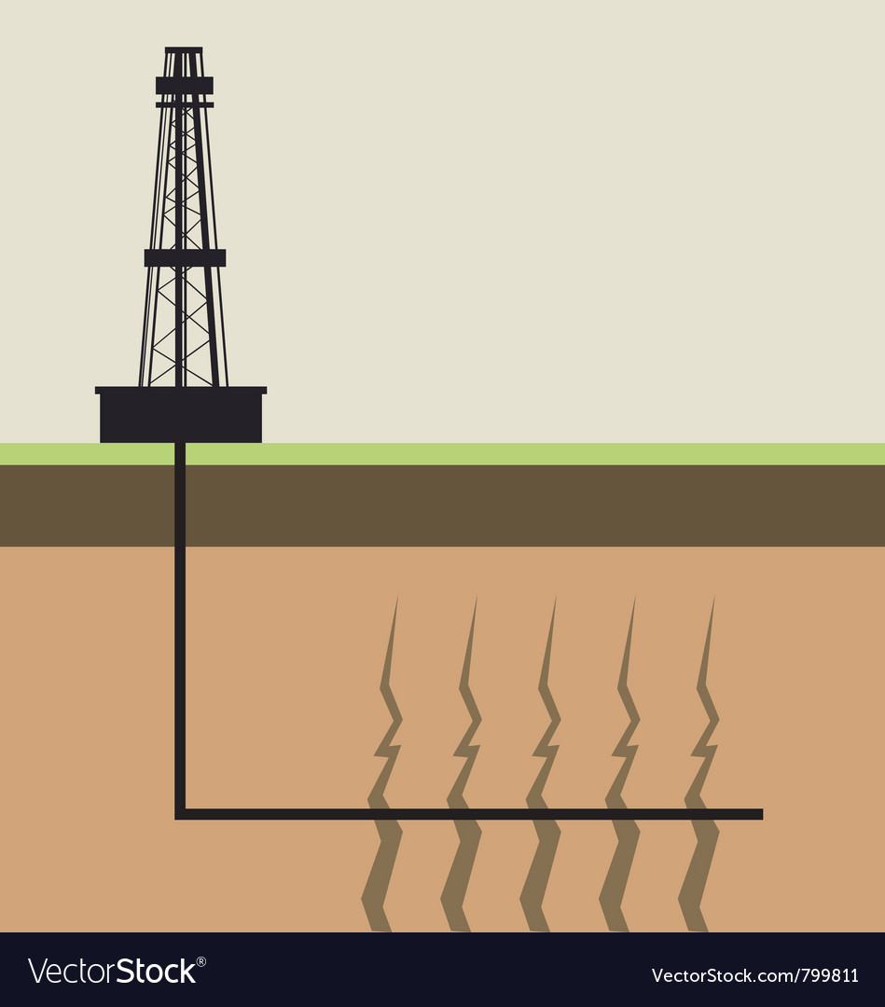
Conceptual Model/Data Understanding
​
Well ID
Unique code – industry standard for easy location identification
Completion Design
-lateral length
-proppant tonnage
-water used
Water
4-6 million gallons on average
Could be stored:
-Impoundments
-storage tanks
-piped from nearby source
Flowback water is stored, treated, reused if possible
Prep to drill
Clear the land of trees
Level the land
Gravel placed
Three holes drilled
Vertical portions
Stages
Determined from length of the well drilled
How fracturing occurs
Placed once casing is finished and gradually opened as needed.
Research
Mineral rights
Survey for well pad
OOIP considered for direction and placement
Land Owners
Environmentalists
Casing
-Well is cased and finally cemented
-important for preventing outside contaminants from entering the well and to protect from leakage out of the well
-different sizes
Production Measures
(how much of each is produced determines efficiency of return)
Oil (Bbl)
Gas
Water (returned – needs to be treated)
Proppant
Housed on site
Sand & Water (95%)
Acids (.5%)

Slide 6
Data Dictionary of Original data

Slide 7
Data Cleansing
Delete rows with XX amount of missing data (according to the client's recommendation)
Remove duplicated rows – using UWI as business key to see duplicates easy
Deleted a few columns deemed unnecessary for this analysis
Changed the production casing, intermediate casing, liner casing so it makes sense (according to client's recommendation)
Removed data errors
Added new columns in order to normalize data, including measured and calculated columns.
Added an index key in order to normalize for age of each well.

Slide 8
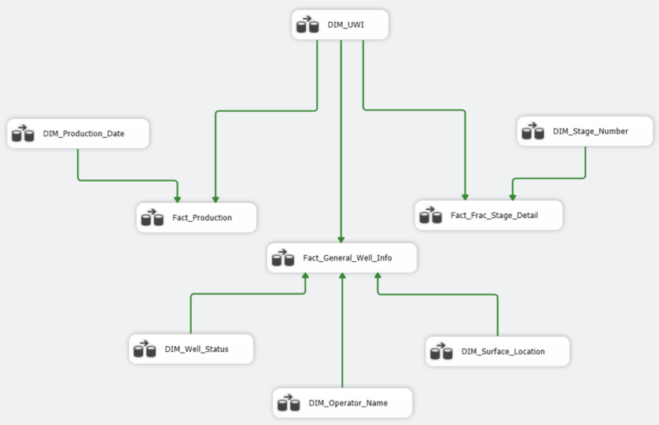
SSIS

Slide 9
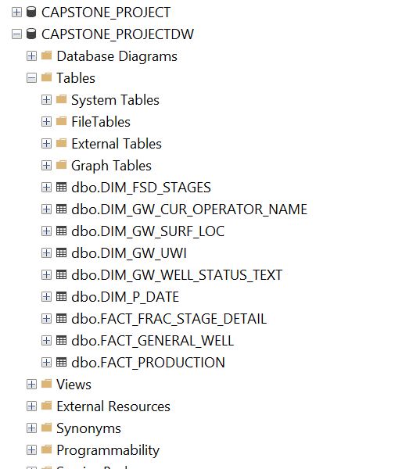
SQL Database

Slide 10
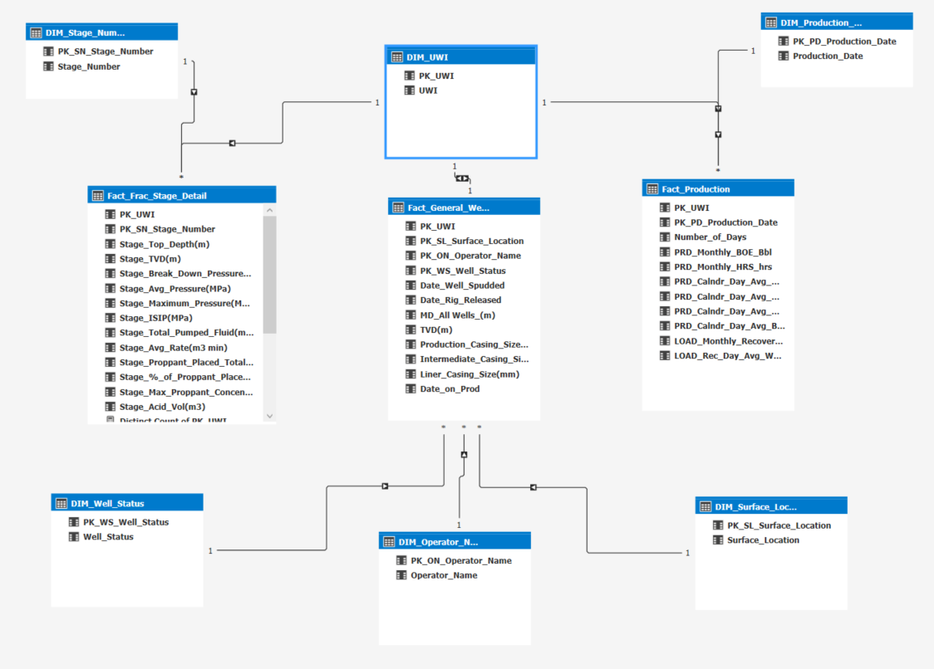
SQL Database Diagram

Slide 11

Microsoft Power BI - VISUALIZATIONS

Slide 12
All Visualizations in GitHub
Link:
Data Story is told following this guideline:
1. Number of Stages
2. Completed Length
3. Completion Overview
4. Casing Sizes
5. Output
6. Water Cut
7. Cumulative water Overview
All Company Names and Unique Well Identifiers (UWI) Redacted for Privacy
The following slides answer the business questions in this presentation based on the visualizations mentioned above. Further reading can be found in the README file:
Link:

Slide 13
Question 1 Answers
Completion parameters such as lateral length and frac stages we noticed some relationship within the IP90 on the analyzed wells.
Completed length increases as the number of stages increases. Many completed wells fall between 2-3k average, while number of stages come in somewhere between 35-40.
Total proppant and fluid pumped show a slight increase as the stage number increases while average daily oil production shows us little relation to the stage number.
Average daily oil production shows a slight increase as the length of the well increases.
Average proppant compared to the completed stage looks to be relatively consistent. Operators have different average proppant usage with the low end being 10 tones per stage and the highest being 19 tones per stage.
Total frac fluid over the completed length shows us a direct relationship. Frac fluid increases as the well increases in size.
Average water cuts shows us the relationship between operators with high frac fluid and high proppant tend to have a higher-than-average water cuts. This could potentially mean they are using to much fluid.
Operators that used a smaller quantity of frac fluid pumped down the well saw lower water cut values on IP90 (2nd visual page)
Higher amount of fluid, higher amount of proppant = $$ potentially lower IP90

Slide 14
Question 2 Answers
Analyzing the frac fluid pumped per stage vs avg water and total proppant pumped, did show a relationship. Operators pumping a higher amount of total frac fluid per well (1-2k) proppant (5-12 tonnes/per stage) were lower water cut percentages than operators pumping total frac fluids of (6k) proppant(15-20 tonnes/per stage).
Without further analysis it is hard to determine if this relationship is caused by higher amounts of frac fluid being pumped down the wellbore or if it is the characteristics of the reservoir.
Operator A and Operator B show lower cumulative water production than other competitors. The completion data shows that this could potentially be contributing to these results, but this could also be from reservoir characteristic.

Slide 15
Conclusions
Longer completion lengths with an increase in stage counts did not necessarily show an increase in IP90
Wells with completion lengths <3000 had similar well production performance at IP90 when compared to wells with completion lengths >3000m
Higher amounts of frac fluid pumped showed a higher water cut at IP90 but isn't a definite conclusion to higher cumulative water production or lower cumulative oil production
Operators such as Operator A are having success using lower frac fluid volumes and lower than average proppant tonnages and seeing good well performance at IP90
Casing size did not show any significant relation to production performance. Operators in the area were having success with different casing sizes.

Slide 16
Recommendations

Slide 17
References
Barrel (unit) - Wikipedia
Oil in place - Wikipedia
Unique Well Identifier (UWI) | Petroleum | Growth, Enterprise and Trade | Province of Manitoba
Spud Definition (investopedia.com)
Explore a Fracking Operation - Virtually (fractracker.org)
MPa – Megapascal Pressure Unit (sensorsone.com)
Completion Design - an overview | ScienceDirect Topics
7 Common Project Risks and How to Prevent Them • Asana
Risk Identification | The MITRE Corporation
Fracking Explained | oilandgasinfo.ca

Slide 18
Questions?

